Slide 1
CFG Project (Florist Shop)
Diya Zaman and Victoria Awosode

Slide 2
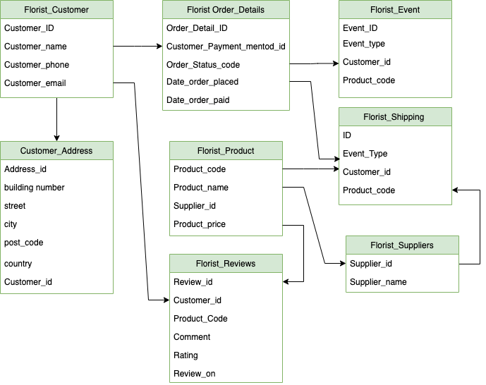
Tables

Slide 3
Introduction- Core Requirement 1 and 2
Table Name | Primary Key | Foreign Key
Product | Product_code
Address | address_id | customer_id
Order Details | Order_Detail_ID | Customer_id
Customer | Customer_ID
Event | Event_ID
Suppliers | Supplier_id | Customer_id Product_code
Shipping | Shipping_ID | Order_Detail_ID
Reviews | Review_id | Customer_id Product_code

Slide 4
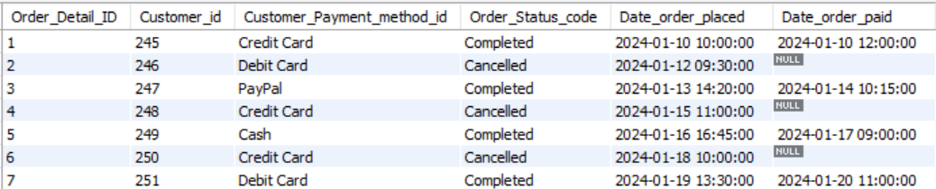
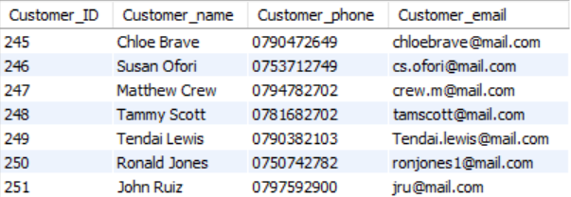
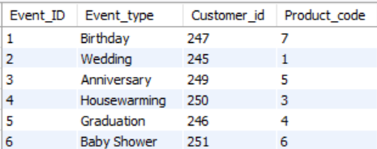
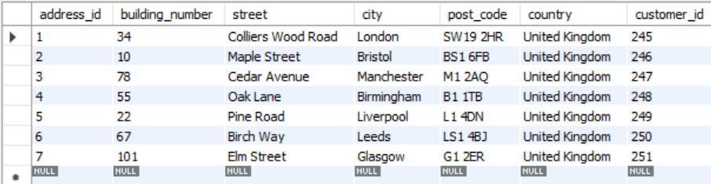
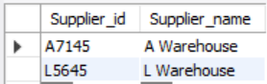
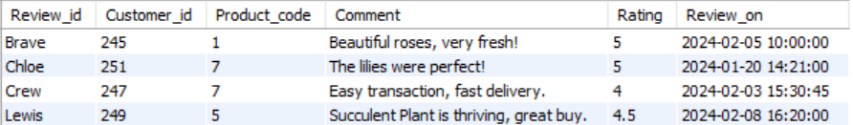
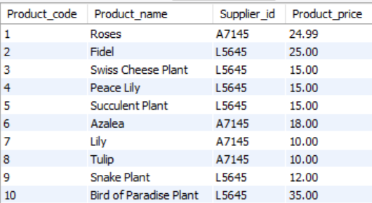
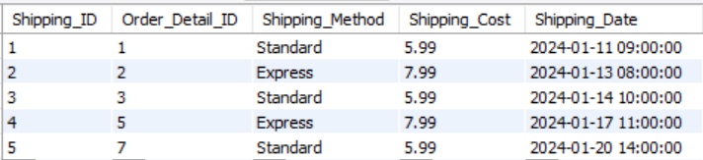
Sample Data

Slide 5
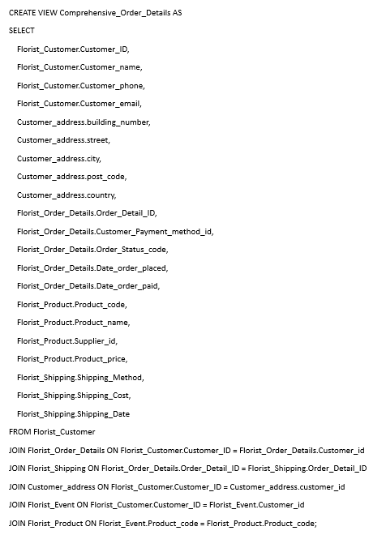
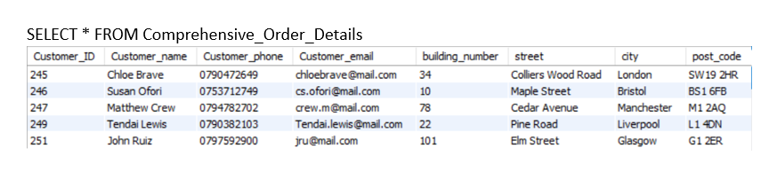
Core Requirement 3- Create a view combining multiple tables in a logical way

Slide 6
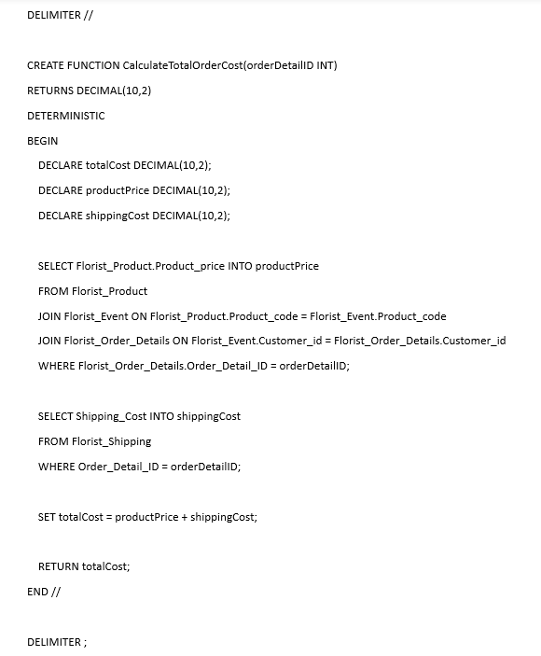
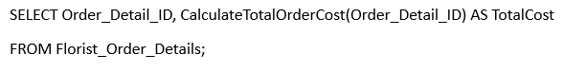
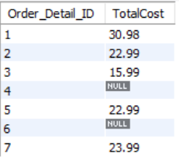
Core Requirement 4- Create a stored function that can be applied to a query
We created a stored function named CalculateTotalOrderCost which takes Order_Detail_ID as input and return the total cost of the order (product price plus shipping cost).

Slide 7
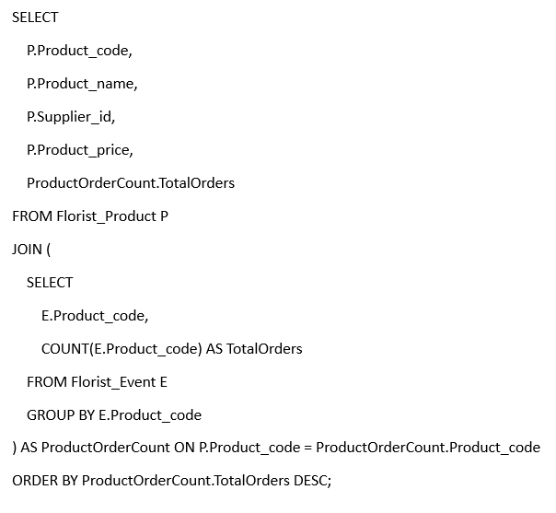
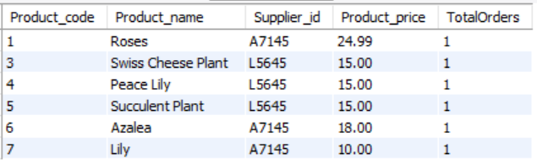
Core Requirement 5- example with a query with a subquery to demonstrate how to extract data from your DB for analysis
This query is useful for identifying the most popular products based on the number of times they have been ordered.

Slide 8
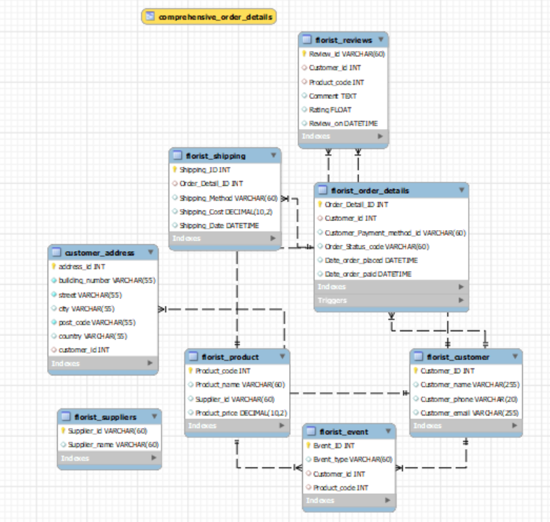
DB Diagram (Core Requirement 6)

Slide 9
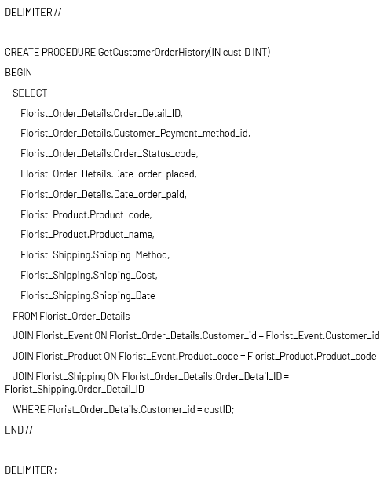
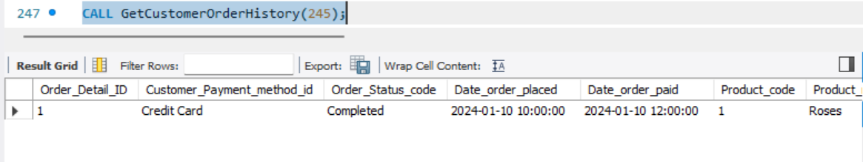
Advanced Requirement 1- Create a stored procedure and demonstrate how it runs
This procedure will take a Customer_ID as an input and return a list of all orders placed by that customer, including details about the products ordered, the order status, and the shipping information. This procedure can be very useful for customer service and tracking customer activity.

Slide 10
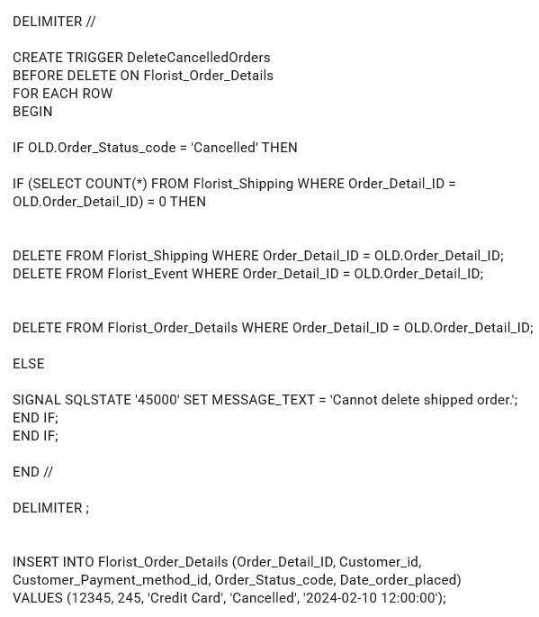
Advanced requirement 2- creating a trigger and demonstrating how it’s run

Slide 11
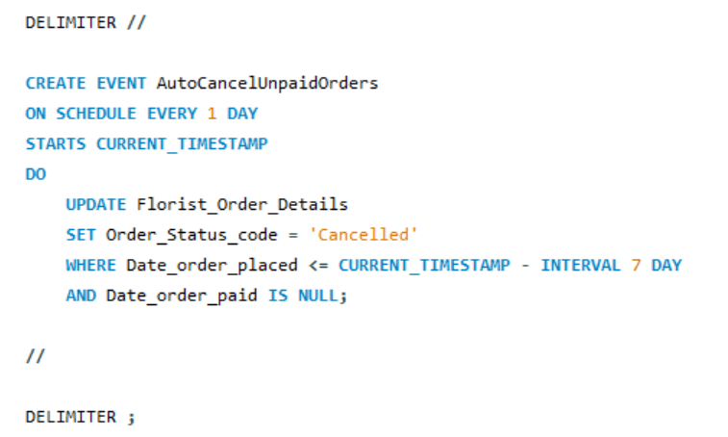
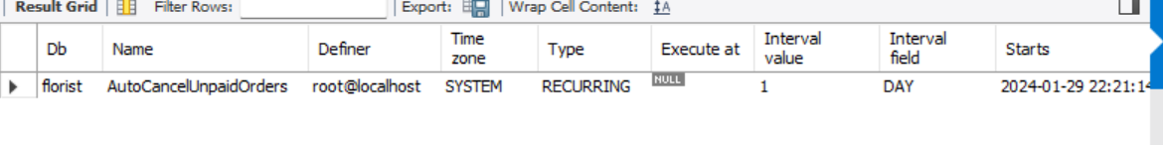
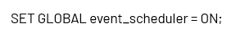
Advanced Requirement 3- Create an event and demonstrate how it runs
A useful event could be one that automatically updates the order status of orders that have been placed but not yet paid for, changing their status to "Cancelled" if they remain unpaid for a certain period (e.g., 7 days).

Slide 12
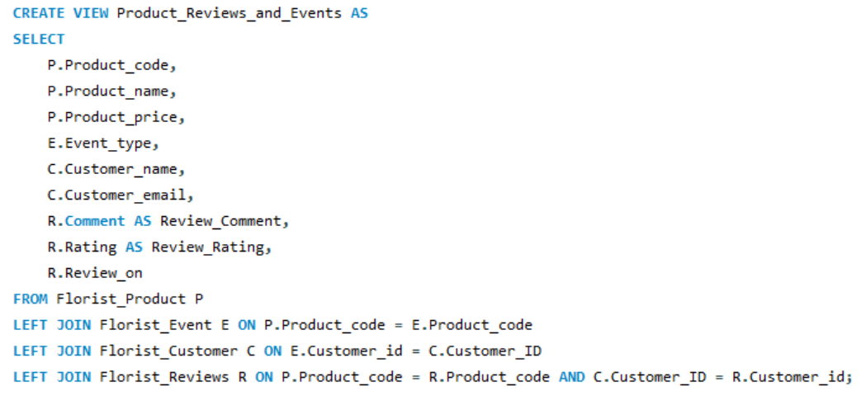
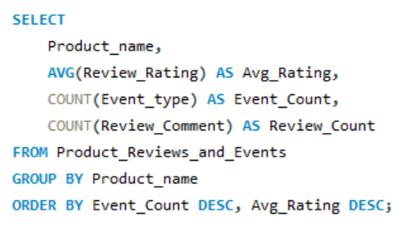
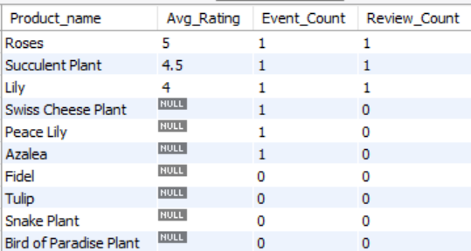
Advanced requirement 4- creating a view that uses 3-4 base tables and demonstrate a query that can be used for analysis
This view will provide information about the products, the events they were purchased for, customer reviews, and the customers who made the purchases. It can provide insights into product popularity, customer satisfaction, and event-specific product preferences.

Slide 13
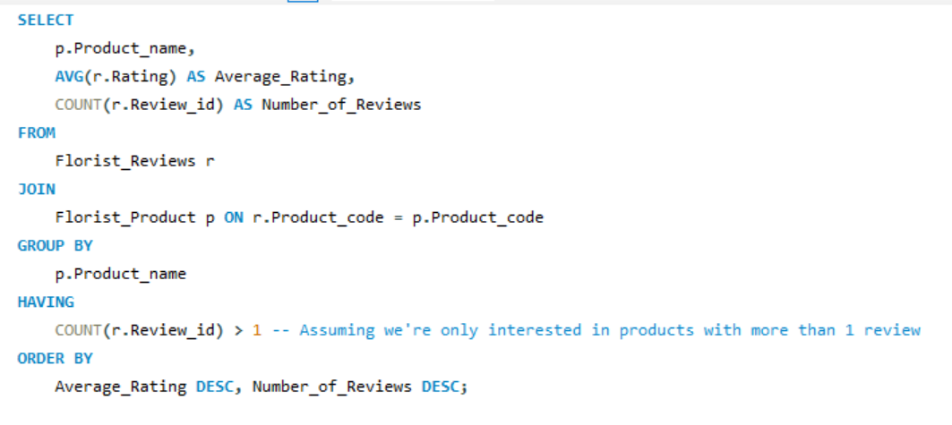
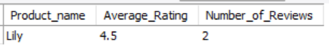
Advanced Requirement 5- Example query with group by and having to demonstrate how to extract data from DB for analysis
e.g This can be used to find products that have received a high average rating in reviews, indicating high customer satisfaction.

